Slide 1
Fusion Restaurant Scheduler
Andreas Richardsen, Mirjana Erceg, Sangey Lama,
Tamas Kalapacs, Zahro-Madalina Khaji

Slide 2
Why did we choose this for our project?
Manual scheduling = time consuming
The new system would benefit all employees
Different system

Slide 3
Interview with Fusion
Problems:
Manual scheduling
Time consuming
Stressful to find replacements

Slide 4
How we agreed on working
We meet up regurarly
In school
Outside od school
Divide the work equally
Our personal goals

Slide 5
Business case
Introduction
Opened 7 years ago
Gourmet restaurant
Serve good food
Management summary
Potential solutions
Do nothing
Licensing an existing system
Creating custom system(recommended)
Conclusion

Slide 6
System scope
System key features:
Display reservation information
Automate calculations of required shifts
Display employee information
Filter employees to find available workers

Slide 7
Use Case prioritisation
Create schedule
Update schedule
Manage employee
Clock in/out

Slide 8
Domain model

Slide 9
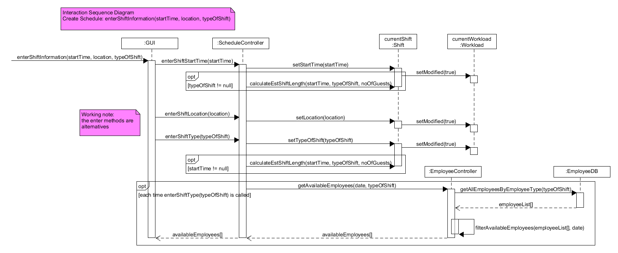
ISD enterShiftInformation

Slide 10
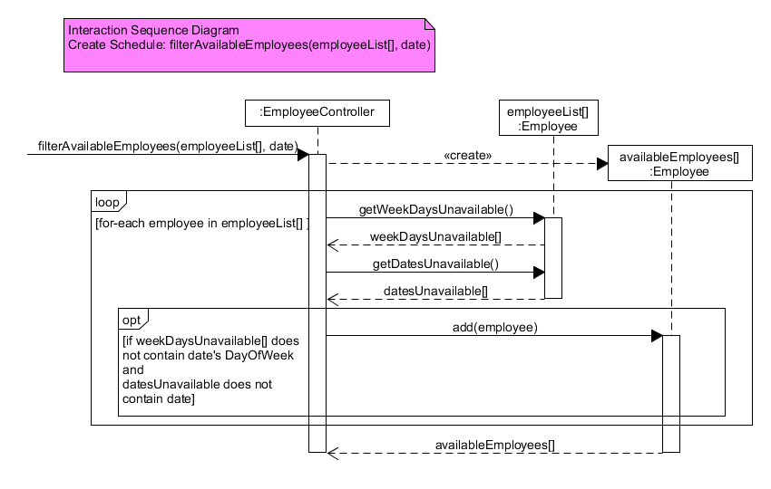
ISD filterAvailableEmployees
Notes:
IT creates an empty list called (available employees) then enters a loop for each employee it checks if they have the current date selected as unavailable or preferred of, then it has an option which say if the employee do not have this date unavailable or preferred off the employee gets added to the list. When the loop ends all the available employees gets added to the list availableEmployees.

Slide 11
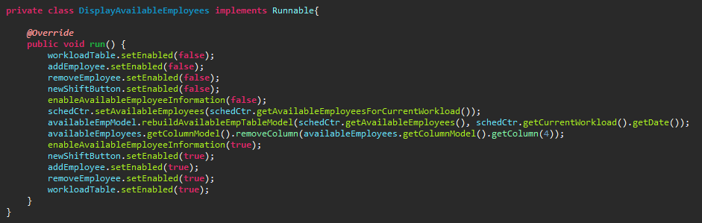
Multithreading
Avoid GUI freezing
Retrieve available employees
Disable some functions
Notes:
For our system, we use multi-threading for time complex operations to avoid GUI freezing. This is a private class from our ManageScheduleGUI class in the GUI Layer, the purpose of this class is to retrieve the available employees for a given workload and display it in a Jtable called availableEmployees. However, while the thread carries out the time complex operation of retrieving available employee there are certain parts of the GUI which need to be disabled and once the operation has completed they are re-enabled.
As you can see it set them all to false and then get the available employees, when it has gotten the employees it then set them to true to re-enable it

Slide 12
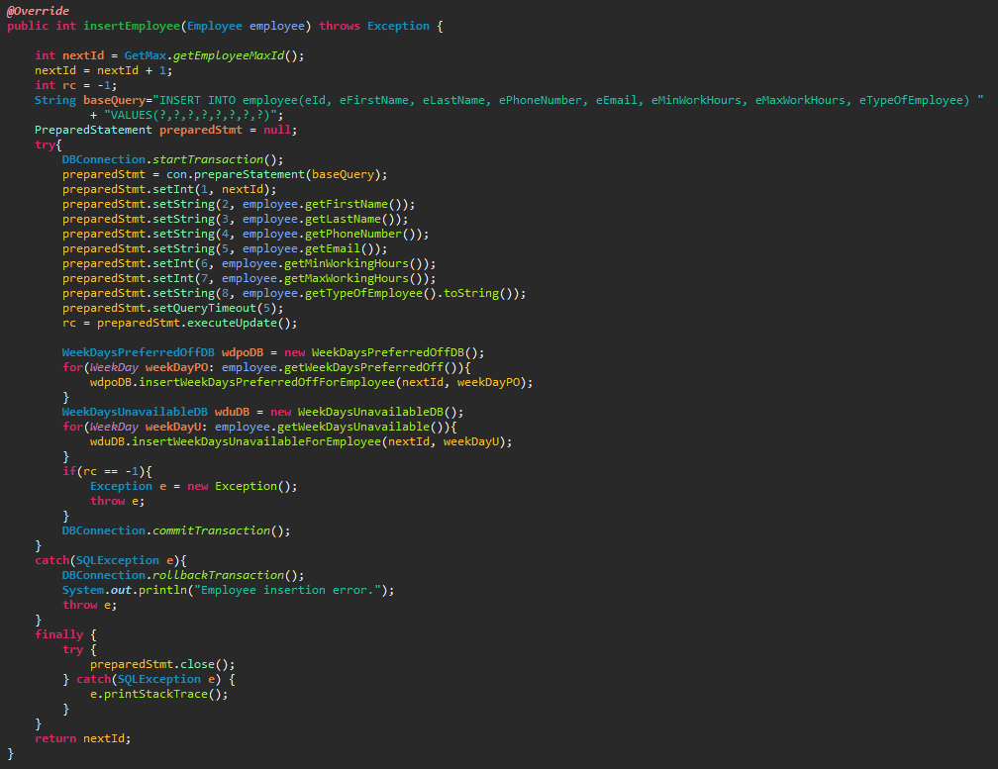
Transaction
All or nothing
Insertion of employee

Slide 13
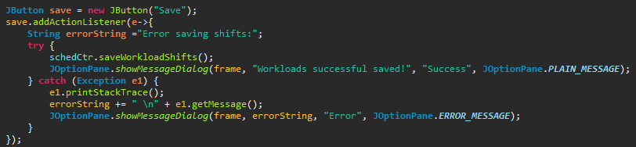
Error handling & Lambda

Slide 14
Prepared statements
Prevent sql injections
? as placeholder
Objects to make statements

Slide 15
Regular expressions
Used in manage employee
Validate textfield inputs
Validate correct dates
Combobox & checklist

Slide 16
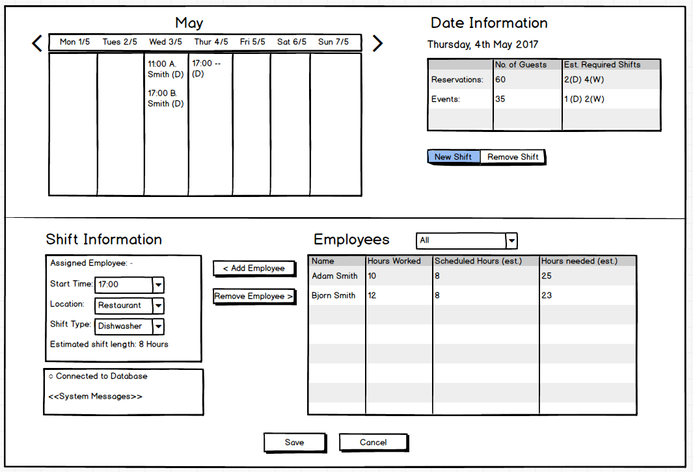
Mock up

Slide 17
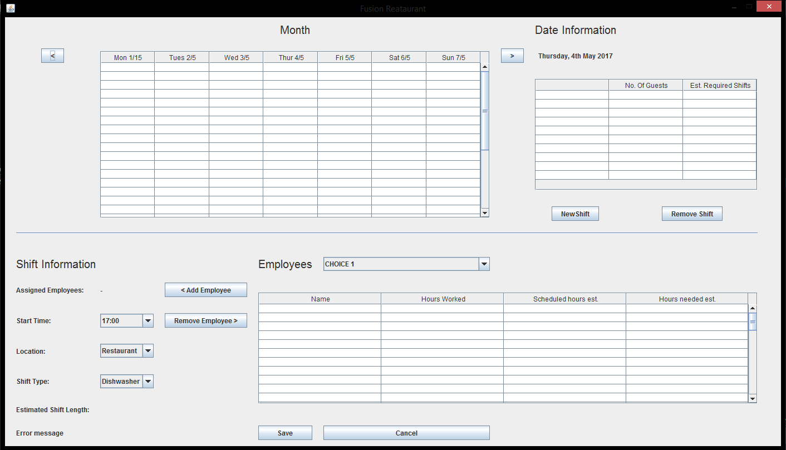
Final design

Slide 18
Future
Automatic scraping
Clocking-in and out
Highlight which employees are preferred off
Change the worked hours
Notes:
Let the managers change the worked hours in case of error

Slide 19
Group work review
Good:
Communication
Participation + contribution
Work ethic
Future improvements:
Maintain motivation
More review + evaluation

